Slide 1
the computational role of motor cortex in trial-and-error learning
lucy lai
03-25-2019
olveczky lab meeting
Notes:
sdfdfsdfsd

Slide 2
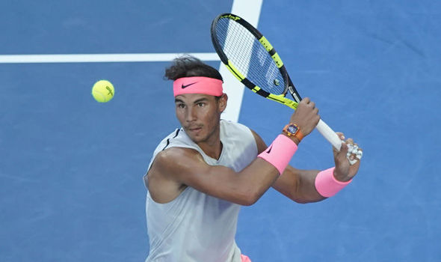
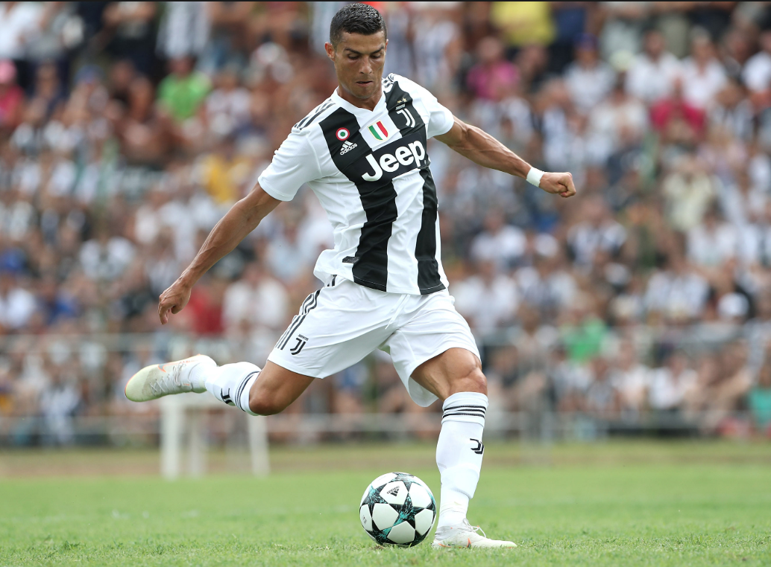
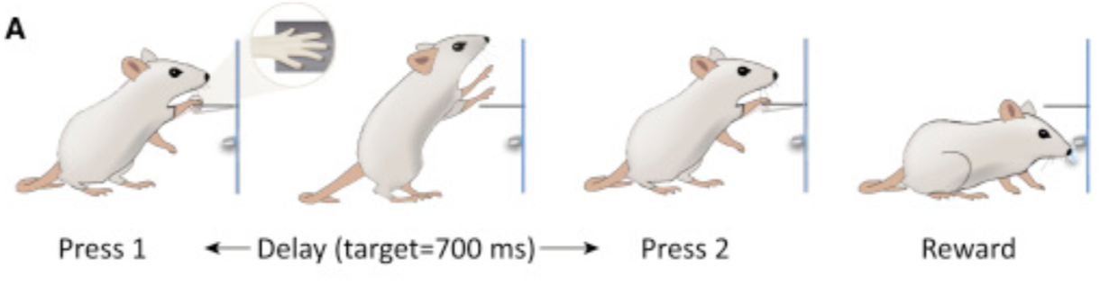
refined motor skills are learned through trial-and-error
sports
reinforcement learning
dfsdf
rats
Kawai et.al. 2015
Notes:
The goal of this rotation project was to help elucidate, using a combination of modeling and analyses, the computational role of motor cortex our favorite trial-and-error learning task.
Can be thought of as a question of RL, where an agents actions are shaped by external rewards.

Slide 3
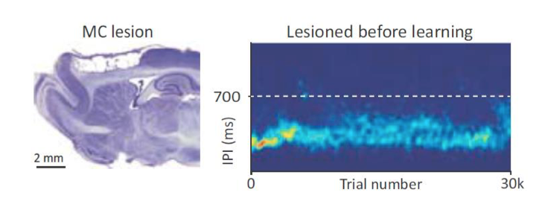
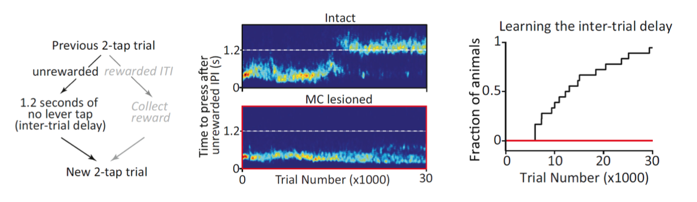
motor cortex is required for learning but not execution
Kawai et.al. 2015
Notes:
The goal of this rotation project was to help elucidate, using a combination of modeling and analyses, the computational role of motor cortex our favorite trial-and-error learning task.

Slide 4
what is the computational role of motor cortex?
reinforcement learning
state discovery
sequence learning
learning the appropriate state space for the task
ITI vs IPI
exploration of different kinds of actions
eligibility traces: learning the timescale for reinforcement
chunking of actions into sequences
Notes:
Previous work in a trial-and-error learning task in rats has shown that motor cortex is required for learning, but not for executing a motor skill. However, the precise computational role of motor
cortex in the learning process has yet to be elucidated. Motor cortex has privileged access to sensory and contextual information from other neocortical areas that may not be available to subcortical motor circuits. We hypothesize that motor cortex is specifically involved in elucidating the state of the environment and providing state information to subcortical regions. Subcortical regions may then utilize this information to shape the structure of motor actions in a manner that optimizes for rewards. To formalize this hypothesis, we will construct a computational model in the language of reinforcement learning to dissect the specific computational role of motor cortex in the state discovery and sequence learning process.

Slide 5
what is the computational role of motor cortex?
reinforcement learning
state discovery
sequence learning
learning the appropriate state space for the task
ITI vs IPI
exploration of different kinds of actions
eligibility traces: learning the timescale for reinforcement
chunking of actions into sequences
Notes:
Previous work in a trial-and-error learning task in rats has shown that motor cortex is required for learning, but not for executing a motor skill. However, the precise computational role of motor
cortex in the learning process has yet to be elucidated. Motor cortex has privileged access to sensory and contextual information from other neocortical areas that may not be available to subcortical motor circuits. We hypothesize that motor cortex is specifically involved in elucidating the state of the environment and providing state information to subcortical regions. Subcortical regions may then utilize this information to shape the structure of motor actions in a manner that optimizes for rewards. To formalize this hypothesis, we will construct a computational model in the language of reinforcement learning to dissect the specific computational role of motor cortex in the state discovery and sequence learning process.

Slide 6
is motor cortex responsible for state discovery?
Question: How do different agents with different beliefs about the task state space act differently when they try to learn the task?
Hypothesis: MC is involved in elucidating state information to subcortical structures. When the right states of environment have been learned, MC is no longer needed to (e.g. expert lesioned)
Predictions: Agents that do not have the right state representations fail to learn sufficiently and/or efficiently.

Slide 7
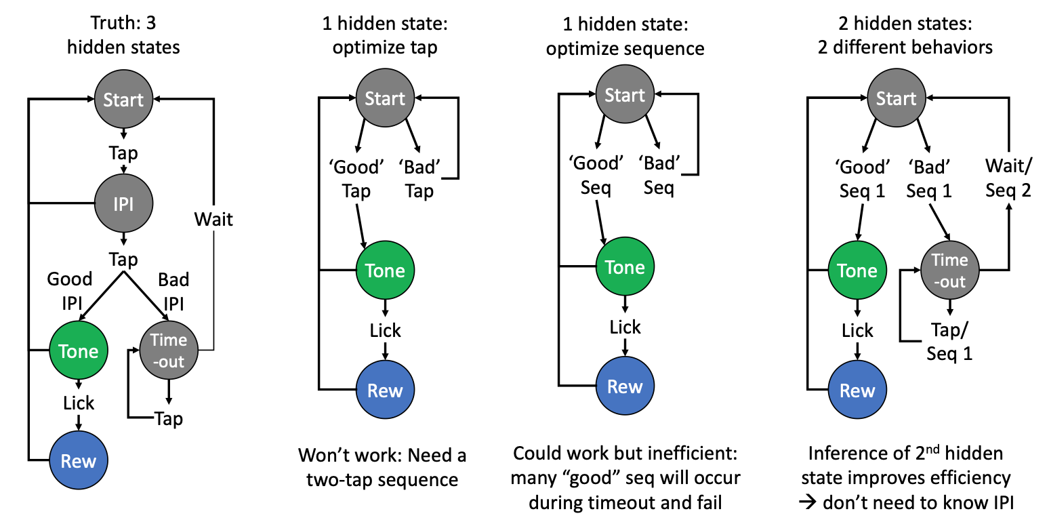
is motor cortex responsible for state discovery?
Predictions: Agents that do not have the right state representations fail to learn sufficiently and/or efficiently.
Gerald Pho

Slide 8
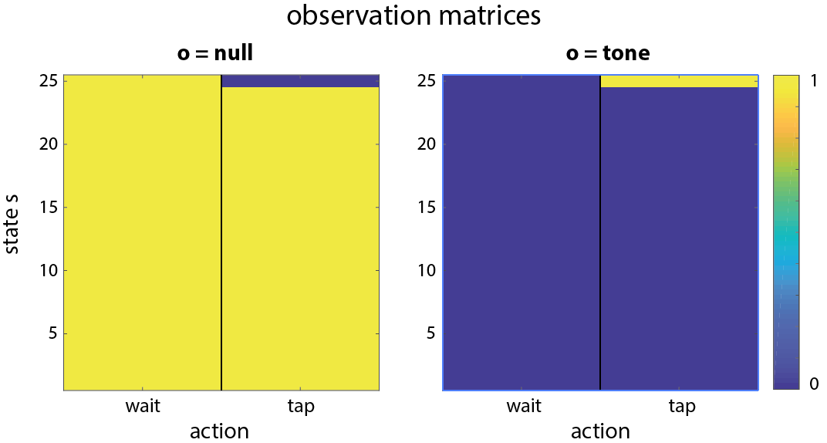
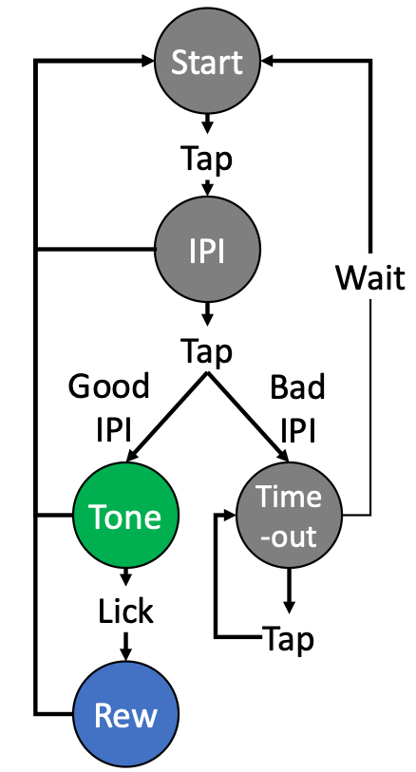
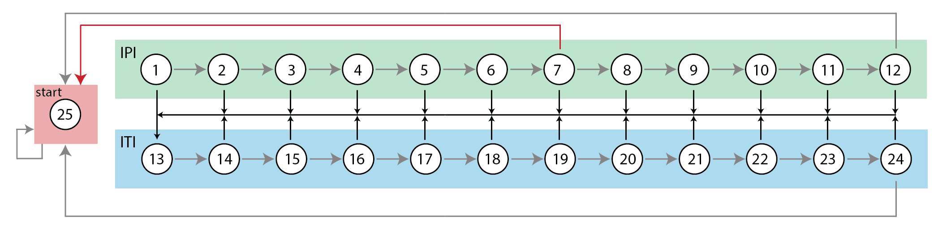
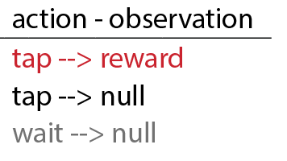
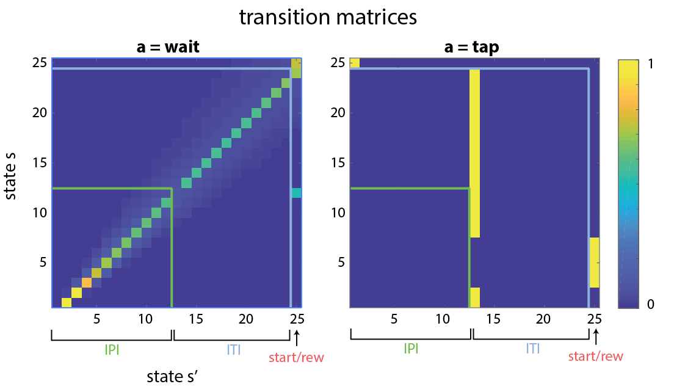
POMDPs for state space inference
Components:
25 States: IPI and ITI separated into 100ms sub-states
2 Actions = {wait, tap}
2 Observations = {null, reward}
Transition matrix T(s,s’,a) = p(s’|s,a)
Observation matrix O(s’,a,o) = p (o|s’,a)

Slide 9
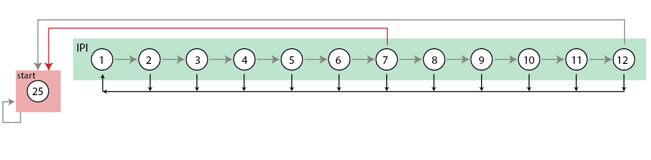
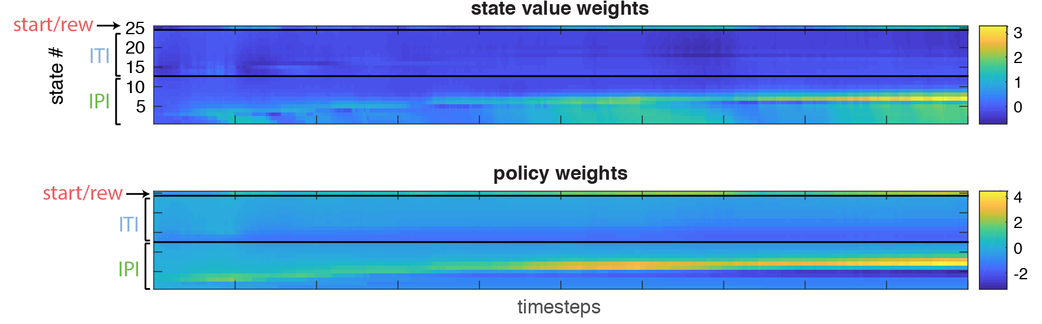
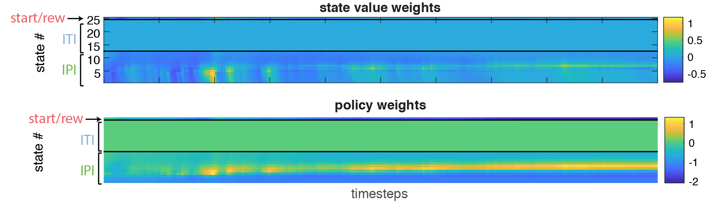
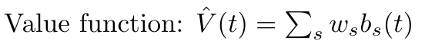
RL agents with different inferred state spaces
Agent 1: Knows ITI
Agent 2: Does not know ITI

Slide 10
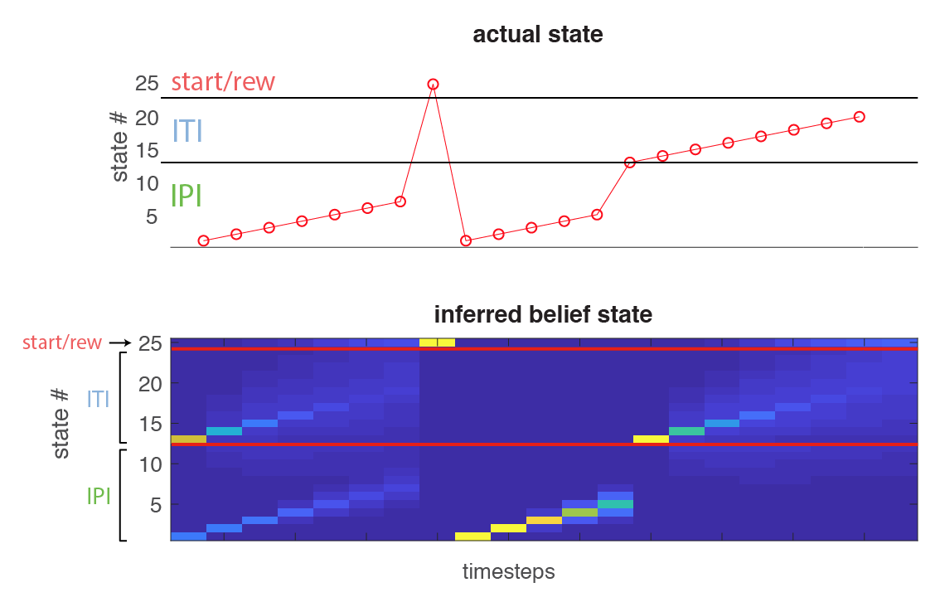
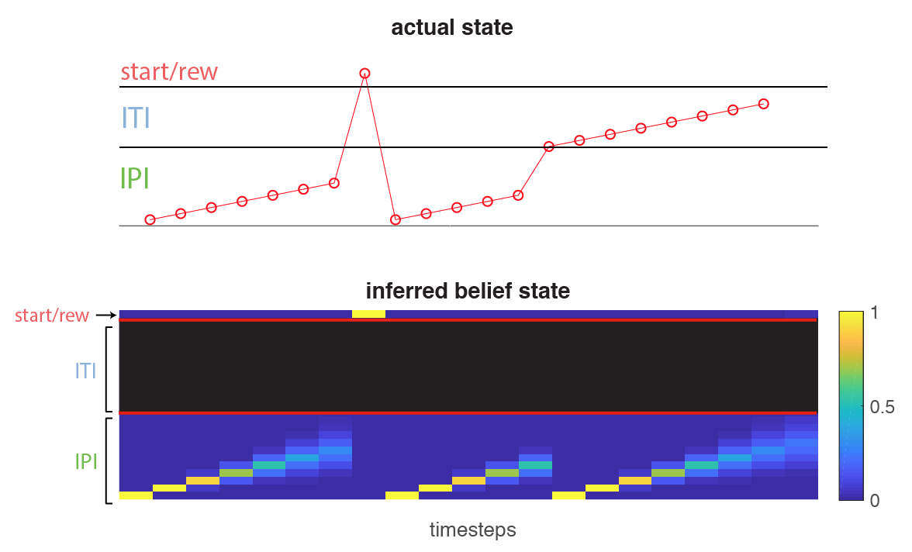
POMDPs for state space inference
Agent 1: Knows ITI
Agent 2: Does not know ITI
tap
tap (early)

Slide 11
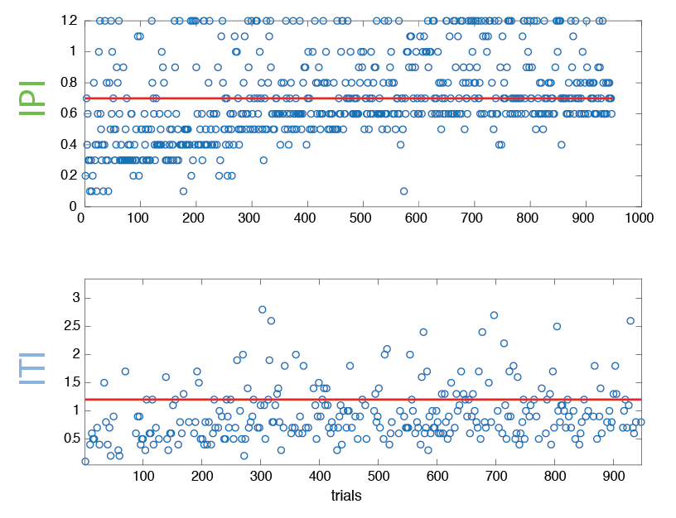
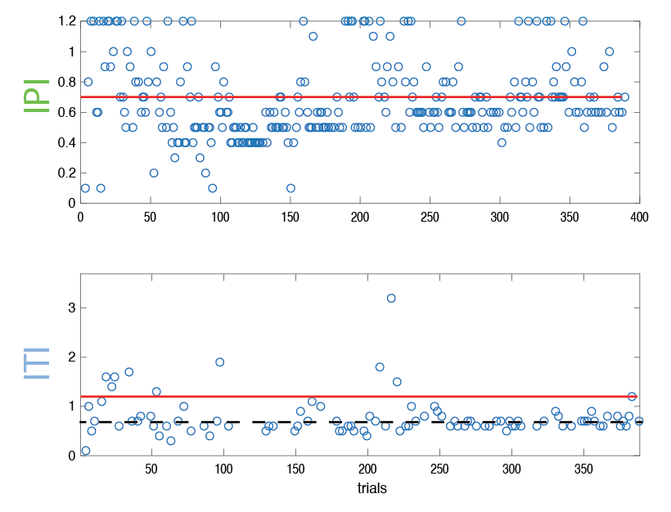
POMDPs for state space inference
Agent 1: Knows ITI
Agent 2: Does not know ITI

Slide 12
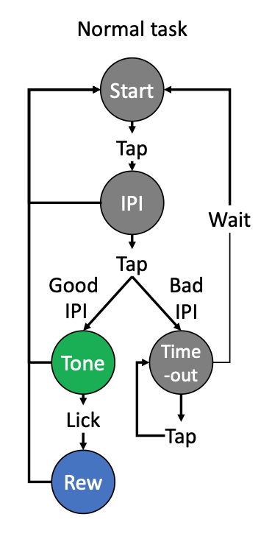
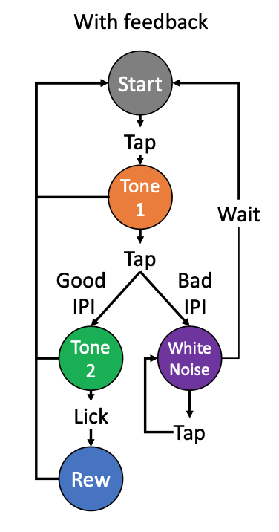
is motor cortex responsible for state discovery?
Rescuing the deficit
Question: Is state information sufficient for learning this trial-and-error task?
Gerald Pho
Notes:
Before switch, tapping indiscriminately After switch, you can see a clear red IPI band that is fairly narrow, but not close enough to 700.
Again argues for some relevance of state discovery but perhaps not the critical factor. Also argues against idea that subcortex can’t do any motor learning with MC(!) -- but maybe just not long sequences

Slide 13
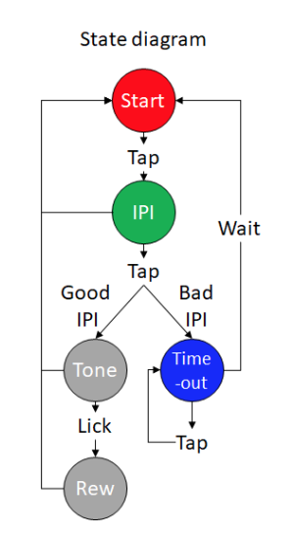
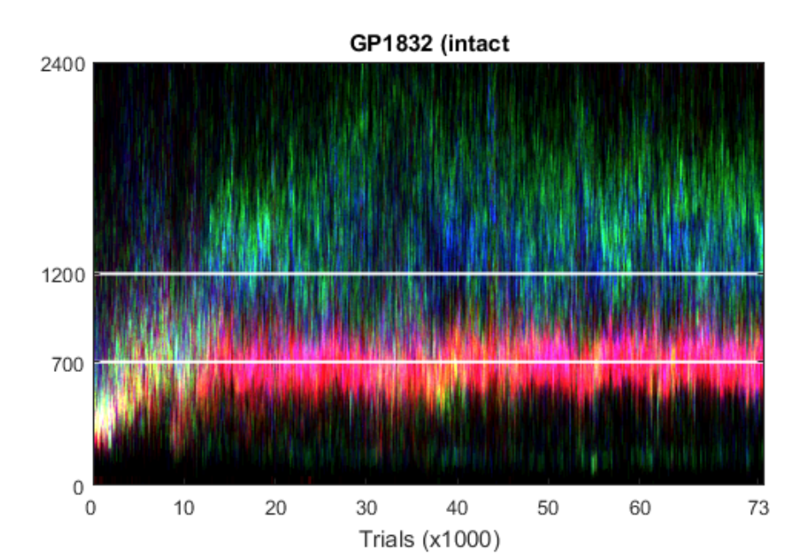
looking at state separation through colored density plots
Gerald Pho
Notes:
Before switch, tapping indiscriminately After switch, you can see a clear red IPI band that is fairly narrow, but not close enough to 700.
Again argues for some relevance of state discovery but perhaps not the critical factor. Also argues against idea that subcortex can’t do any motor learning with MC(!) -- but maybe just not long sequences

Slide 14
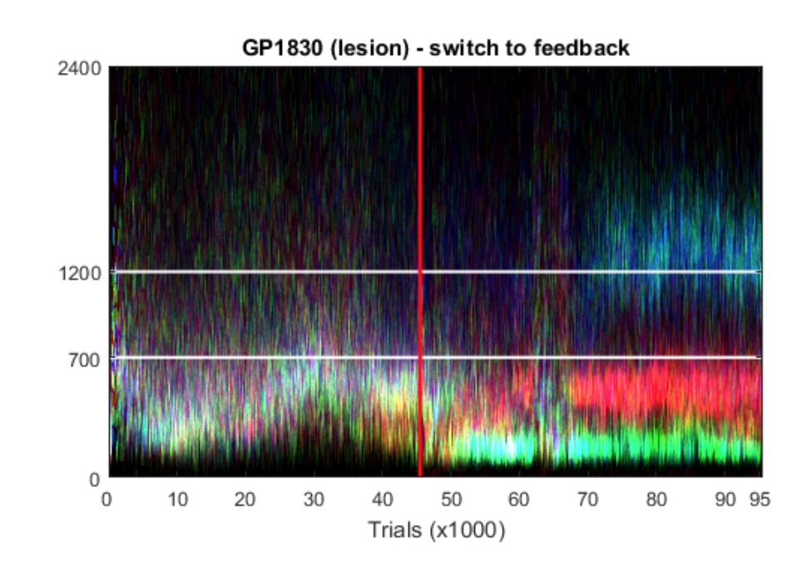
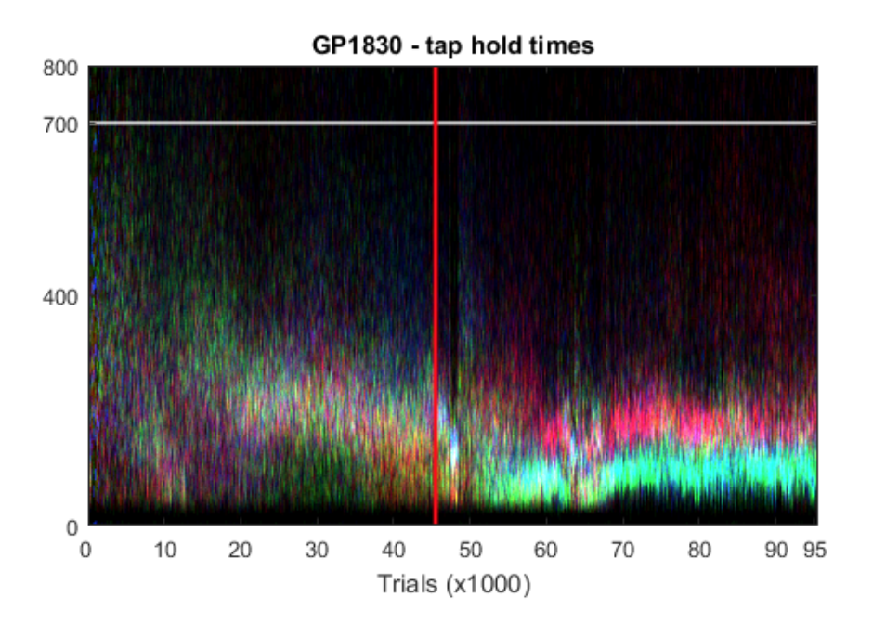
giving naïve lesioned animals feedback about state information
IPI
ITI
Extra
learns state distinction with feedback but IPI cannot improve
introduction of states decreases tap hold times
Gerald Pho
Notes:
Before switch, tapping indiscriminately After switch, you can see a clear red IPI band that is fairly narrow, but not close enough to 700.
Again argues for some relevance of state discovery but perhaps not the critical factor. Also argues against idea that subcortex can’t do any motor learning with MC(!) -- but maybe just not long sequences

Slide 15
is motor cortex responsible for state discovery?
Results
Agents without full knowledge of state information can still learn the task (but inefficient, as predicted)
State information is certainly relevant, but perhaps not the critical factor in learning IPI/ITI successfully
Some limitations
From the perspective of the agent/animal, it’s unrealistic to think that they know that states are parameterized in time
State discovery is unlikely the only process that is impaired with MC lesion
Even without state discovery, an animal can completely learn the task by just generating an arbitrarily long enough sequence that satisfies the task
Notes:
so instead of continuing to explore the other possible state representation models, we thought it

Slide 16
what is the computational role of motor cortex?
reinforcement learning
state discovery
sequence learning
learning the appropriate state space for the task
ITI vs IPI
exploration of different kinds of actions
eligibility traces: learning the timescale for reinforcement
chunking of actions into sequences
Notes:
more bottom up approach..

Slide 17
is motor cortex responsible for sequence learning?
Question: How do naïve lesioned and intact animals learn a sequence of actions? How do they decide how to shape their actions with respect to reward?
Hypothesis: Animals learn and refine sequences by refining the kinematics (e.g. position, velocity) of their taps.
Predictions: Certain differences between intact and lesioned animals with respect to how they learn from rewards:
Lesioned animals can learn from rewards (standard RL), but perhaps have a shorter eligibility trace; they are unable to form longer sequences.
Intact animals should begin to reinforce the transitions between taps (longer sequences), while lesioned animals cannot.
Notes:
\

Slide 18
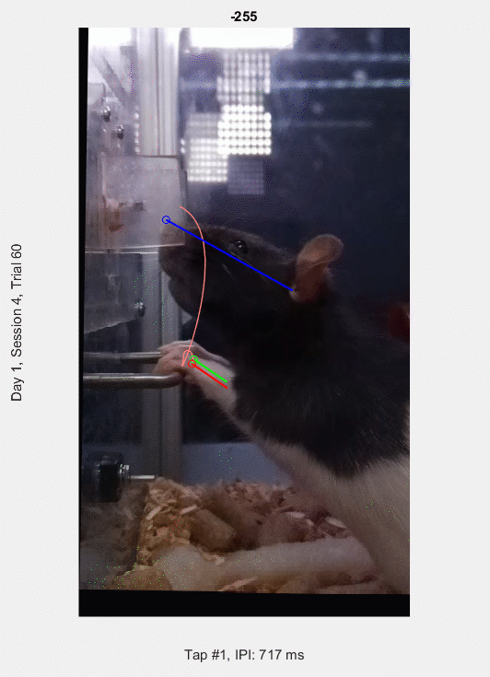
understanding the tap data
“tap”:
-250ms before to 50ms after lever press
Position and velocity data from both paws + head
concatenate into large vector
n x t matrix of
n taps
t timepoints
Notes:
we tried to tackle this problem in the following way:

Slide 19
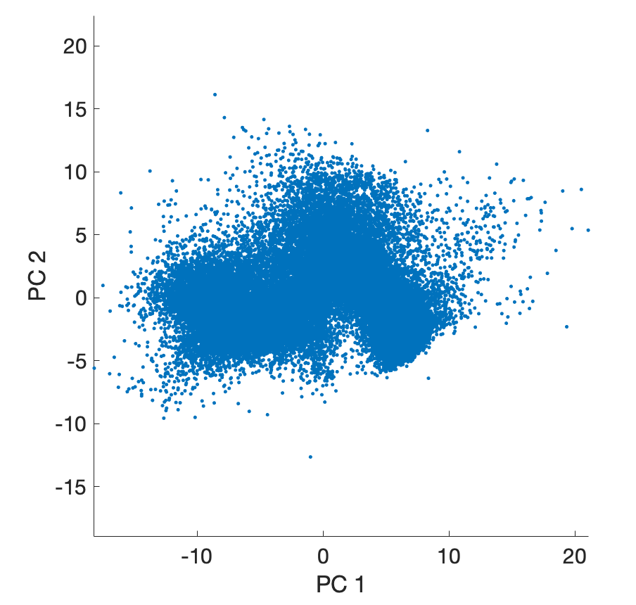
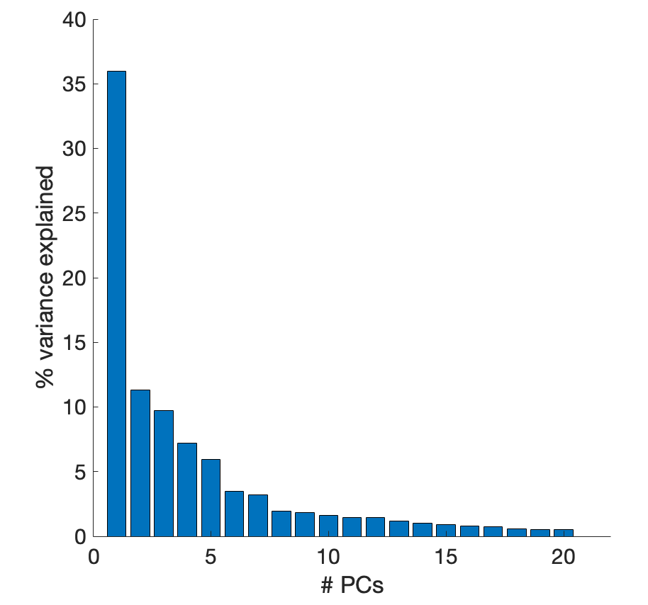
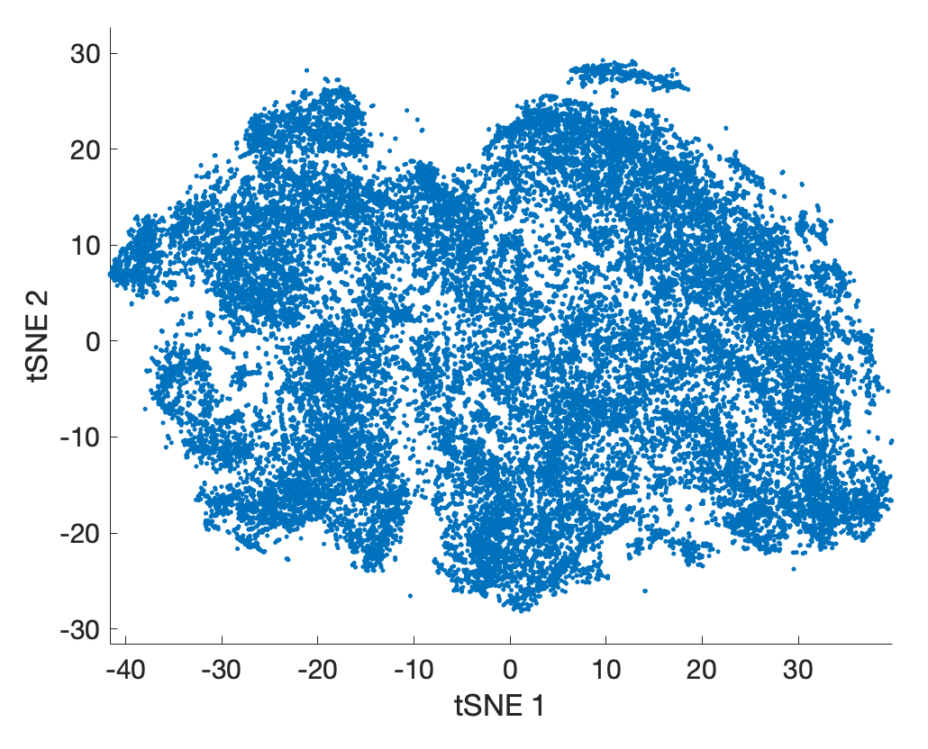
understanding the tap data
“tap”:
-250ms before to 50ms after lever press
dimensionality reduction
PCA
Position and velocity data from both paws + head
take the first k PCs that explain 99% of variance
concatenate into large vector
tSNE
n x t matrix of
n taps
t timepoints

Slide 20
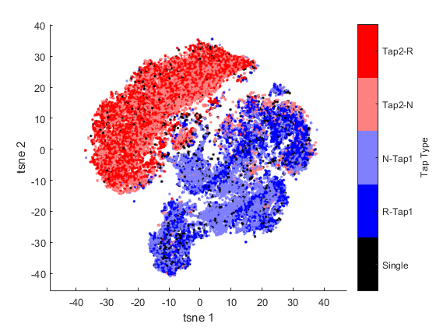
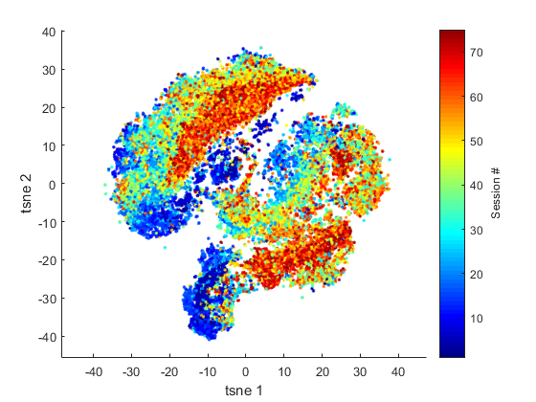
visualizing the diversity of taps
colored by tap 1/tap 2 and rewarded/not rewarded
colored by session
intact animal
Gerald Pho

Slide 21
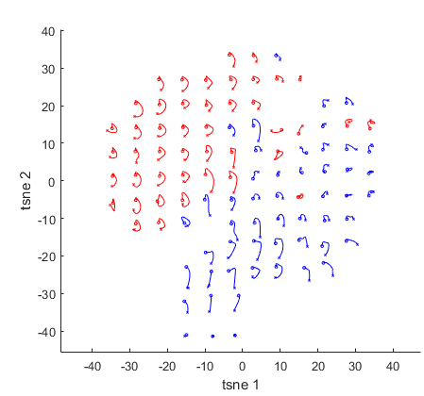
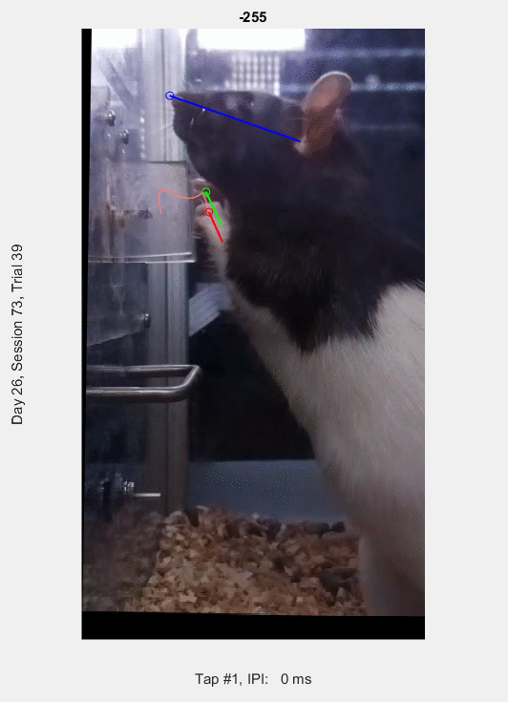
visualizing the diversity of taps
Gerald Pho

Slide 22
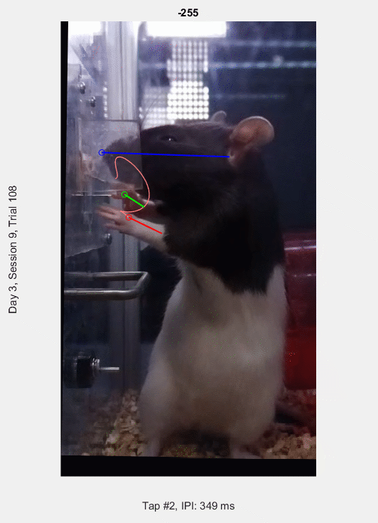
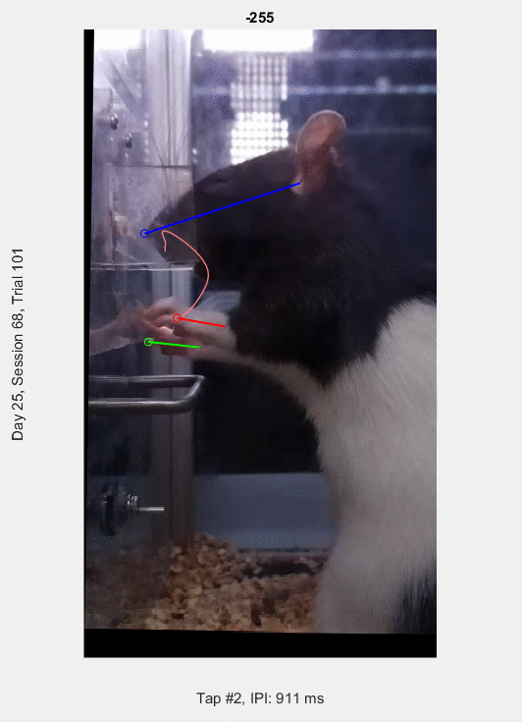
visualizing the diversity of taps
Gerald Pho

Slide 23
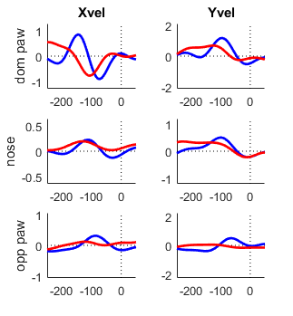
similar taps can occur at very different times
Gerald Pho

Slide 24
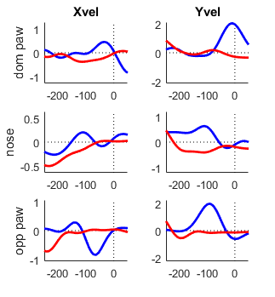
feature differences in dissimilar taps
Gerald Pho

Slide 25
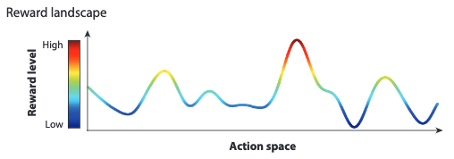
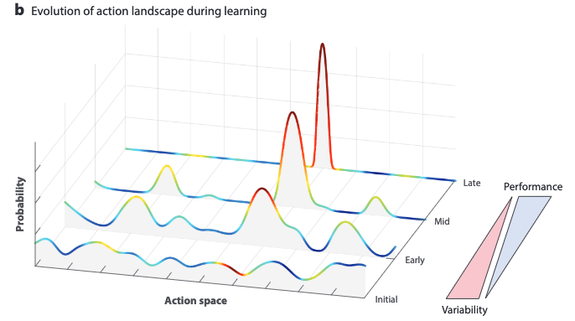
how do taps evolve over the course of learning?
RL specifies that reward should reinforce certain actions
our particular challenge: reward landscape always changing
what is the timescale of change? fast vs. slow change?
does ordinal position matter?
is tap 1 or tap 2 reinforced first?
at what point does the animal begin reinforcing transitions to formulate longer sequences?
Dhawale et.al. 2017
Notes:
RL specifies that reward should shape future actions
we will examine two particular animals, one intact and one lesioned to get at this question more carefully

Slide 26
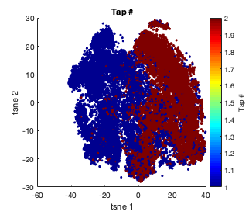
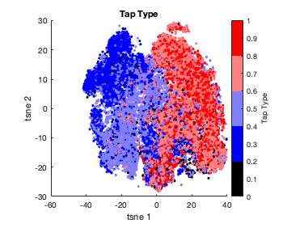
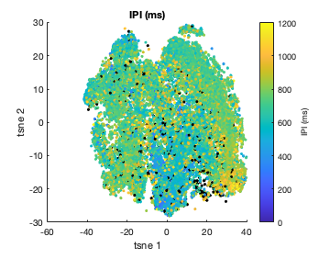
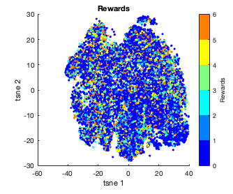
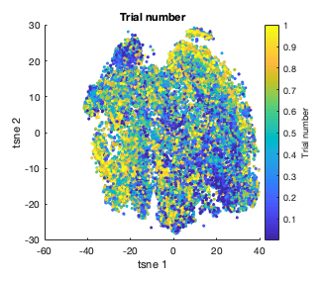
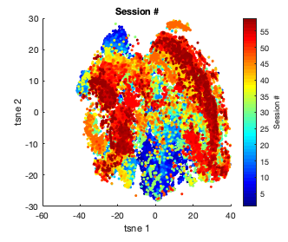
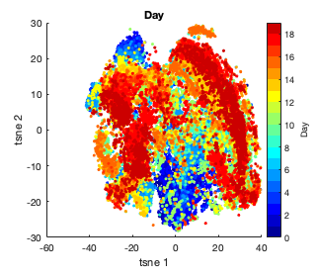
how do taps evolve over the course of learning?
GP1840 (intact)
Notes:
- what info is purely from kinematics
- regression of IPI

Slide 27
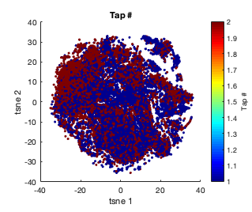
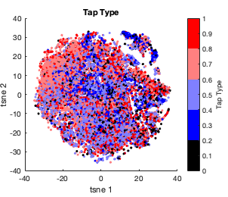
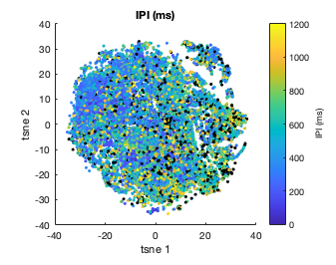
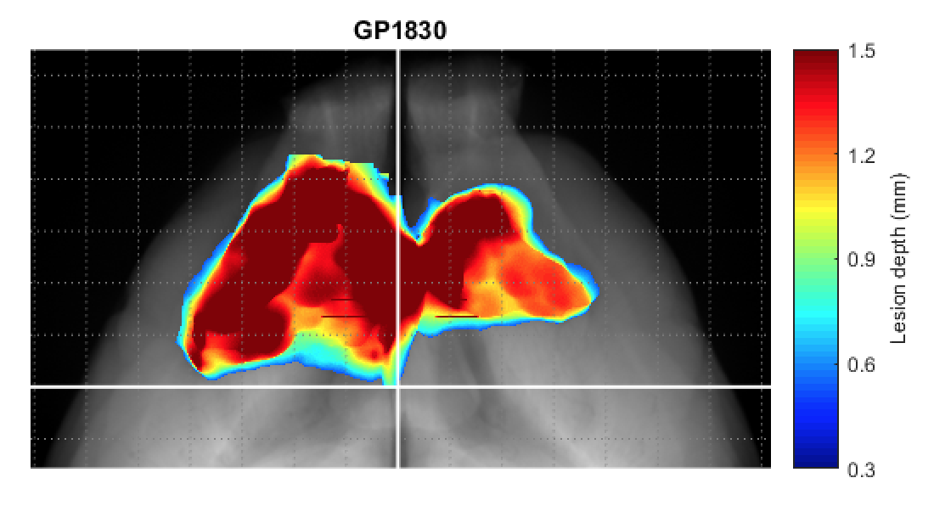




how do taps evolve over the course of learning?
GP1830 (lesion)

Slide 28


defining tap “modes”
tSNE
watershed to find “modes”
Notes:
- clustering in high-D space
- watershed is arbitrary

Slide 29


how do taps evolve across learning?
GP1840 (intact)
~17.8k
IPI
ITI
Extra
Notes:
tifirst use intact animal for cleanest data

Slide 30



how do taps evolve across learning?
GP1840 (intact)
~17.8k
IPI
ITI
Extra
Notes:
ti

Slide 31



how do taps evolve across learning?
a dynamic portrait of how the frequency of taps change across time.
how do rewards modulate tap frequency?
Notes:
do taps
computer as a lag with a. window of 100 rials

Slide 32


how do taps evolve across learning?
analysis approach (feedback needed!)
take ratio between rows
Notes:
all rows Too many clusters: not enough data points per clusters
Too few clusters, not enough power to do a correlation..

Slide 33
how do taps evolve across learning?
analysis approach (feedback needed!)
take ratio between rows
correlate all rows with avg reward rate
positive correlation → tap was upregulated by previous reward
negative correlation → tap was downregulated by previous reward
Notes:
all rows Too many clusters: not enough data points per clusters
Too few clusters, not enough power to do a correlation..

Slide 34

how do taps evolve across learning?
but…problems ☹
things tried
binary reward
different bin sizes (maybe reward acts along a shorter timescale)
watershedding in different # clusters
too many clusters: not enough data points per clusters
too few clusters, not enough power to do a correlation..
Early in learning
Middle of learning
Late in learning
Notes:
tToo many clusters: not enough data points per clusters
Too few clusters, not enough power to do a correlation..

Slide 35


how do taps evolve across learning?
first taps only

Slide 36

qualitative pass: first taps only (early in learning)
first taps only
first taps

Slide 37

qualitative pass: first taps only (late in learning)
first taps only
first taps

Slide 38


how do taps evolve across learning?
second taps only
first taps (for reference)

Slide 39

qualitative pass: second taps only (early in learning)
second taps only

Slide 40

qualitative pass: second taps only (early in learning)
second taps only
tried cross correlation…
nothing came out of it, data are too noisy ☹

Slide 41


how do transitions between taps evolve across learning?
approach
take first 5000 and last 5000 taps
only look at complete trials (no 1-tap trials)
only look at transitions between tap 1→ tap 2

Slide 42

how do transitions between taps evolve across learning?
different ”modes” emerge→
animal switching between
2 kinds of tap1 and 2 kinds of tap 2

Slide 43


how do taps evolve across learning? (lesioned)
GP1830 (lesion) | feedback
~16.8k
IPI
ITI
Extra
Notes:
tifirst use intact animal for cleanest data

Slide 44


how do taps evolve across learning?

Slide 45

how do taps evolve across learning?
first taps only

Slide 46

how do taps evolve across learning?
first taps only

Slide 47


how do taps evolve across learning?
second taps only

Slide 48

how do taps evolve across learning?
second taps only

Slide 49



how do transitions between taps evolve across learning?

Slide 50
is motor cortex responsible for sequence learning?
Results
taps and transitions evolve over the course of learning
qualitatively, tap frequency does seem to track reward rate (intact)
Going forward
Need better analyses to deal with noisy data!
Can do the same analyses on transitions
Are lesioned animals able to learn at the level of transitions?
Why would some animals learn 2 different modes?
Bottom-up analyses can in turn inform future simulations
Notes:
Do in so instead of continuing to explore the other possible state representation models, we thought it

Slide 51


other rats
GP1829 (lesion)
~16.8k trials

Slide 52


Slide 53


GP1829 (lesion)

Slide 54





Slide 55


Slide 56


other rats
GP1831 (lesion)
~20.3k trials

Slide 57


Slide 58


GP1831

Slide 59

other rats
GP1832 (intact)
~17.8k trials

Slide 60


Slide 61


GP1832 (intact)

Slide 62






Slide 64


other rats
GP1838 (intact)
~16.7k trials

Slide 65


Slide 66


GP1838 (intact)

Slide 67
things I learned and people to thank
things learned
data is messy
the importance of distilling a big problem down into manageable chunks
bottom-up and top-down methods can (should!) work in synergy
bottom-up observations inform top-down modeling, which then inform better models and new experiment
thank you guys!
bence
gerald
olveczky lab
chocolate
Notes:
learned about data
data is messy but makes it more interesting
learned about what kind of science I like doing
learned a lot about myself
skeptical (too much) sometimes just need a push over the edge to get analyses done

